Slide 1
GitHub Classroom
Asya Shklyar
March 2018

Slide 2
Summary
At least two departments use GitHub for classroom/coursework
Biology (Andre) and Env Analysis (Marc)
Investigating GitHub Classroom could be useful for them and others
Marc had attempted to integrate but did not have the time
Standardizing on one tool would make support easier
Automation is built-in
Teaching students git gives them an advantage when they graduate and look for jobs

Slide 3

https://classroom.github.com/

Slide 4
It is Open Source
If something is missing or not working we can add it
There is a growing community since 2016
There is online training
There are educational videos and recordings from conferences about other institutions implementing it
It took me 10 minutes to set up the first classroom

Slide 5
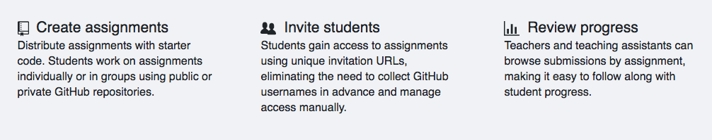

Slide 6
Some links to the test environment I created
https://classroom.github.com/classrooms/34660867-pomona-its-classroom
https://classroom.github.com/classrooms/34660867-pomona-its-classroom/roster
https://classroom.github.com/a/q7M2t0V7 (Individual Assignment)
https://classroom.github.com/g/A5vFtxtM (Group Assignment)

Slide 7

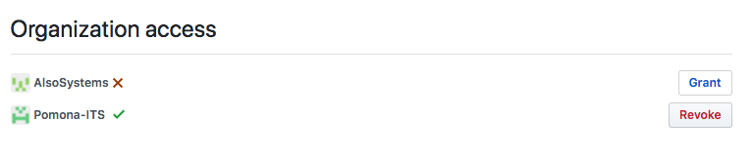

Slide 8
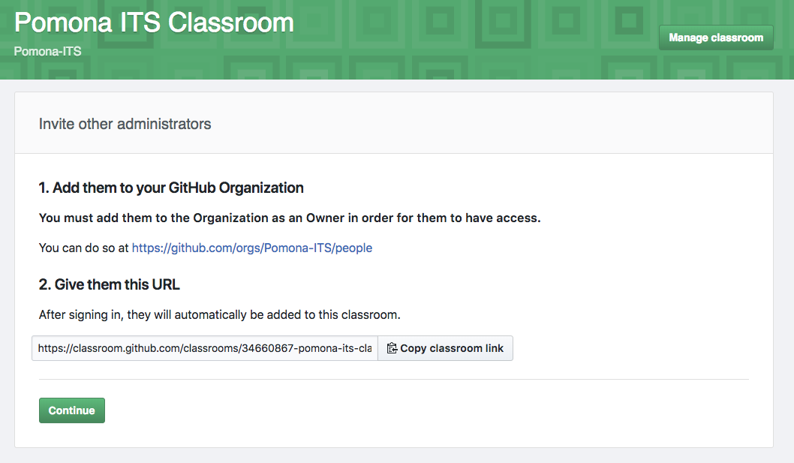

Slide 9
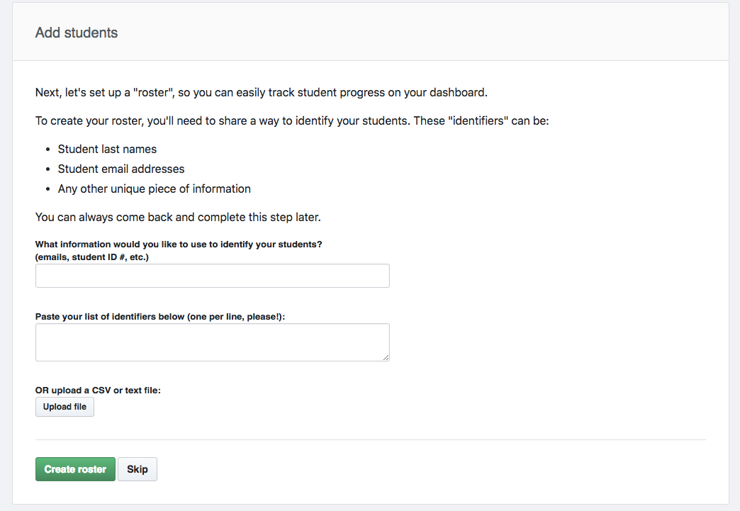

Slide 10
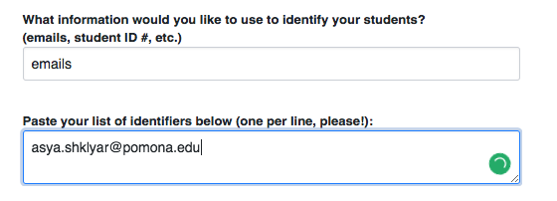

Slide 11
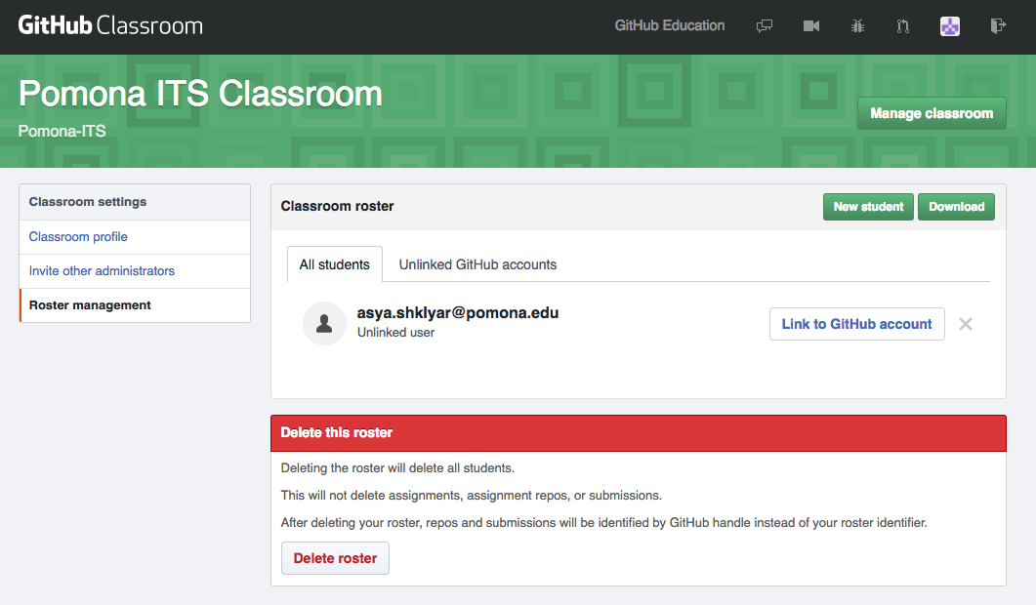

Slide 12
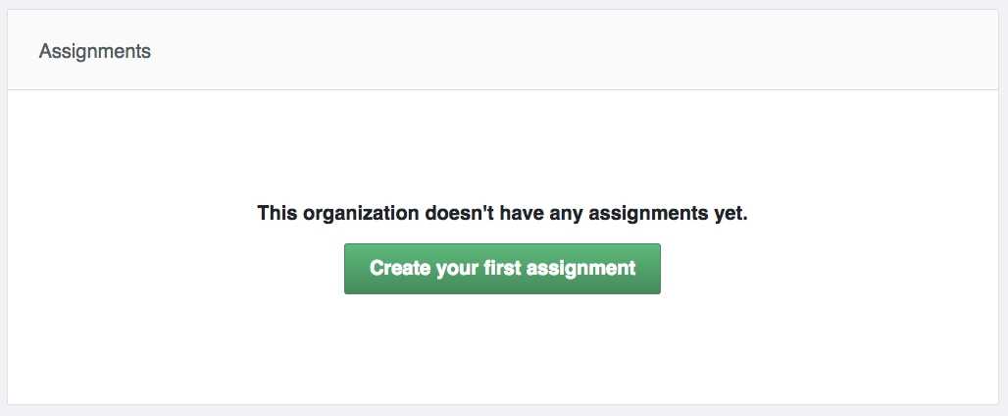
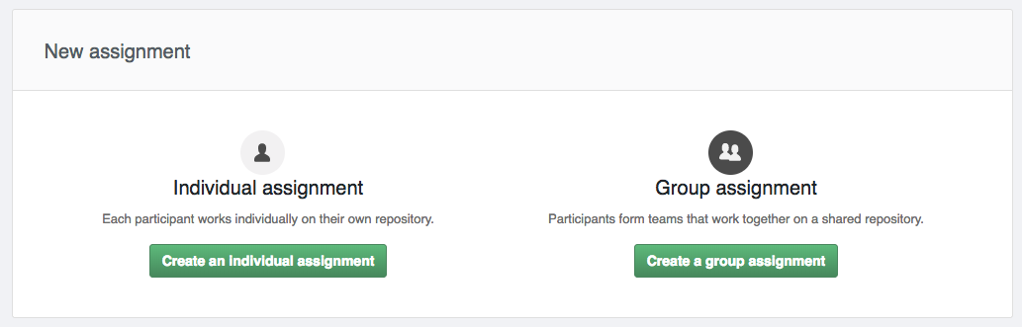

Slide 13
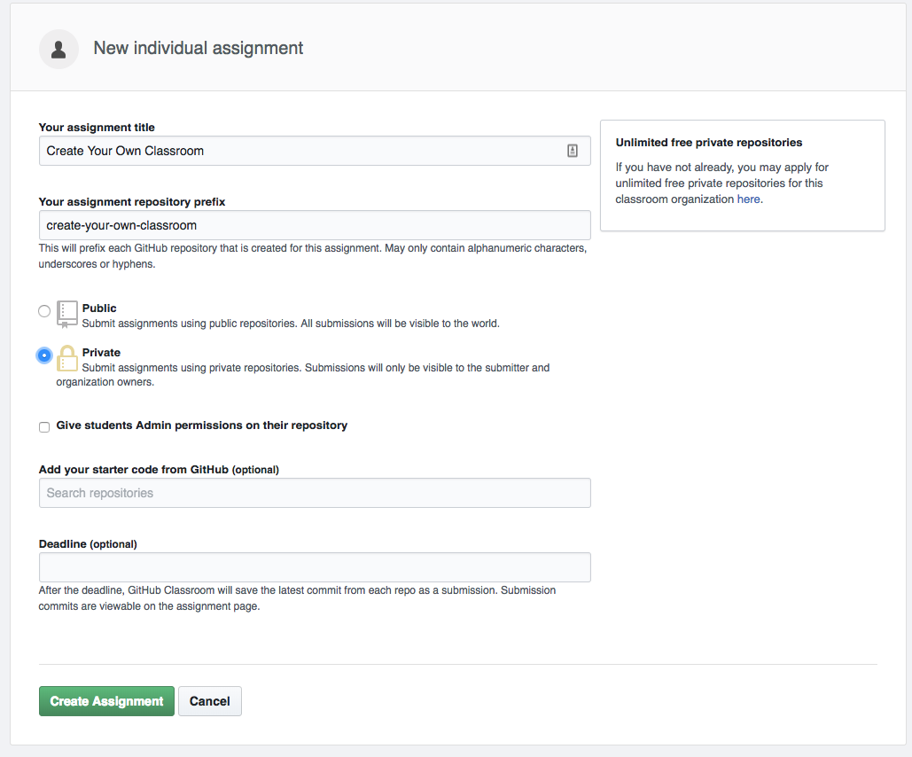

Slide 14
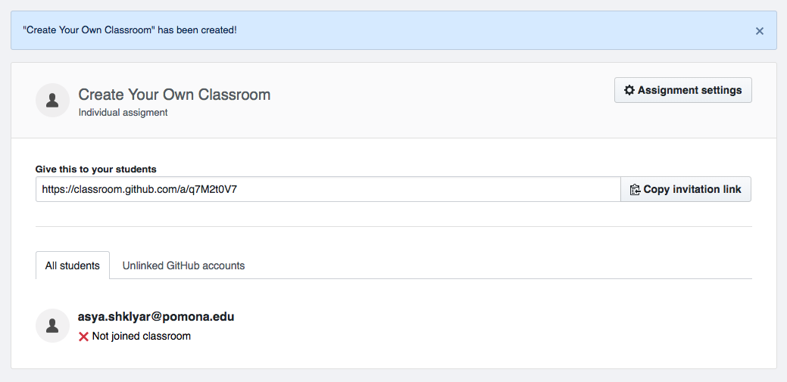

Slide 15
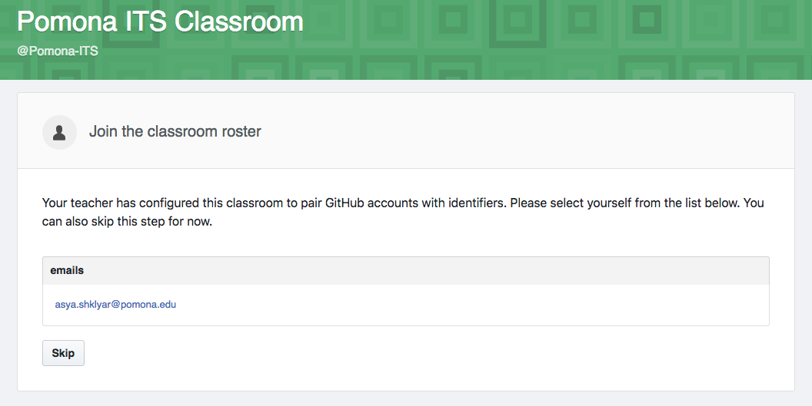

Slide 16
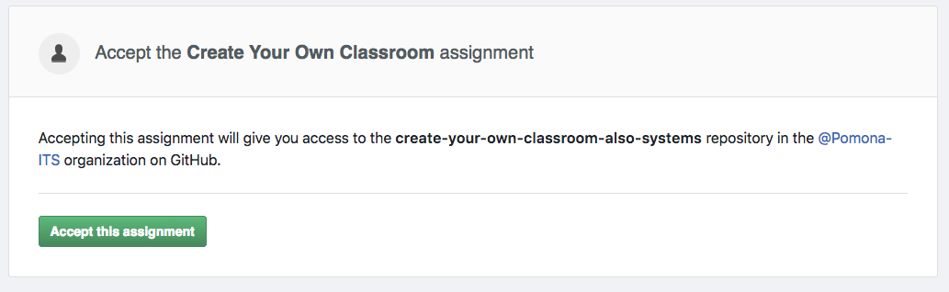
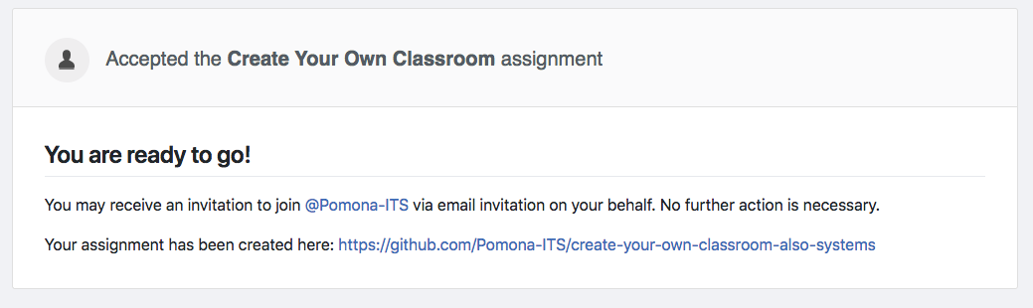

Slide 17
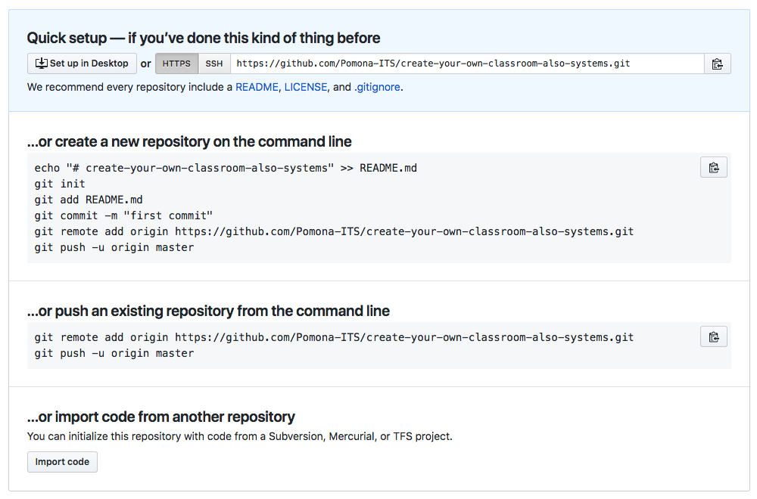

Slide 18
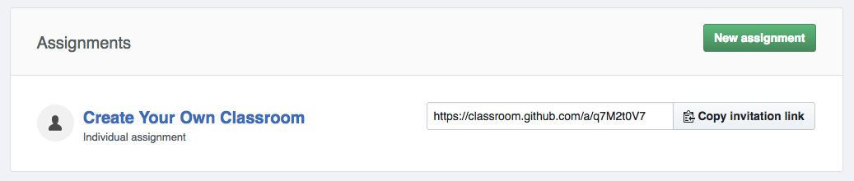

Slide 19
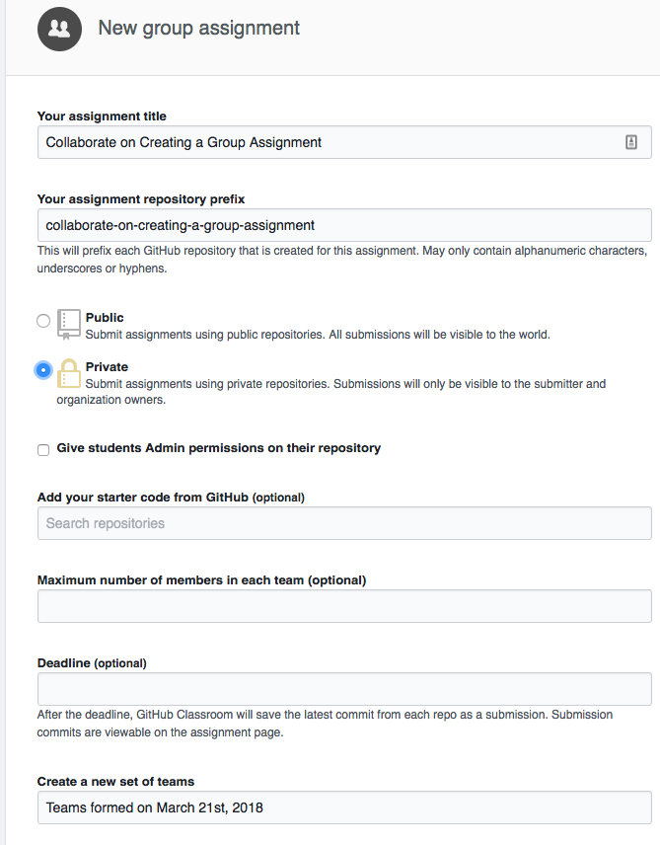
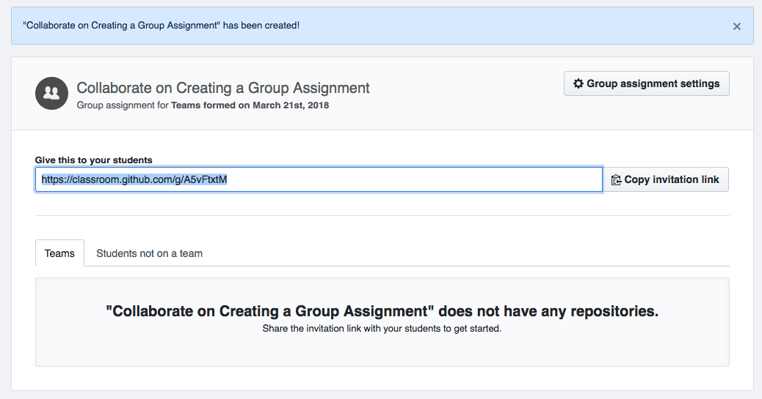

Slide 20
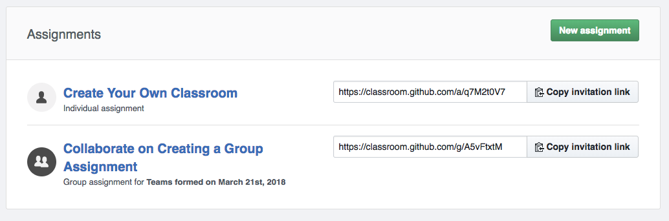

Slide 21
Additional Resources
Getting Started:
https://www.youtube.com/watch?time_continue=13&v=ChA_zph7aao
Individual Assignments:
https://www.youtube.com/watch?v=rTsfBAV7sOo
Group Assignments:
https://www.youtube.com/watch?v=-52quDR2QSc
How someone implemented GitHub in their classroom:
https://www.youtube.com/watch?v=3j1BaUw53pM
More videos at GitHub Education YouTube channel:
https://www.youtube.com/channel/UC0d5sKy-bIVtQn0gW78S8YQ
https://www.youtube.com/watch?v=uxyhXlZgg5g

Slide 22

Teacher training to master Git and GitHub https://education.github.com/advisors

Slide 23
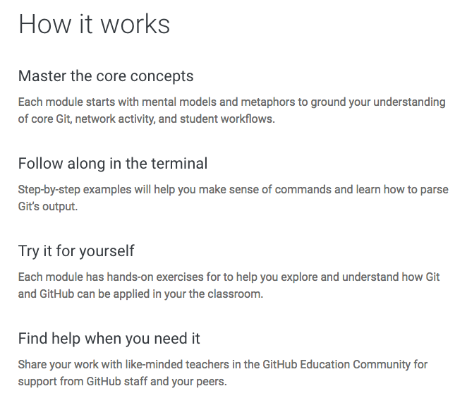

Slide 24


Slide 25


Slide 26
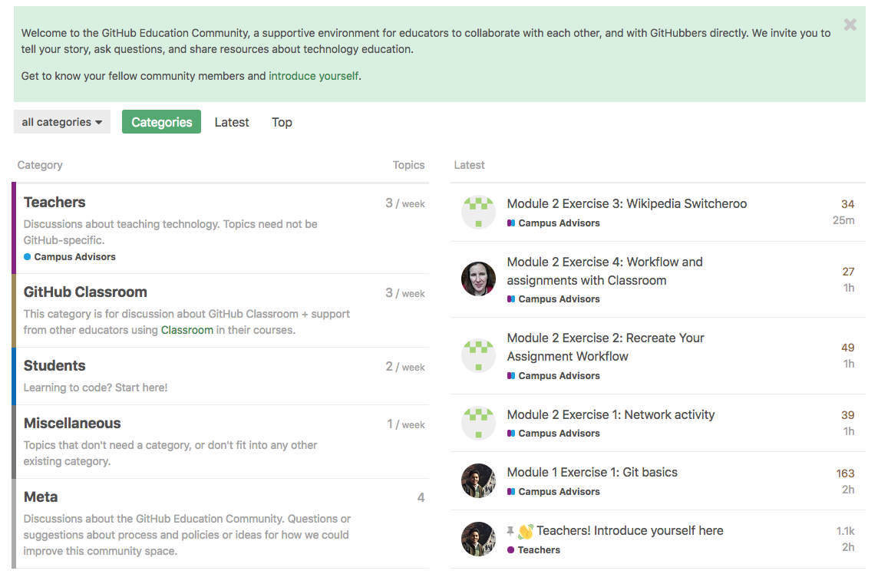
https://education.github.community/

Slide 27

And a paper!
http://alexeyza.com/pdf/cscw15.pdf

Slide 28
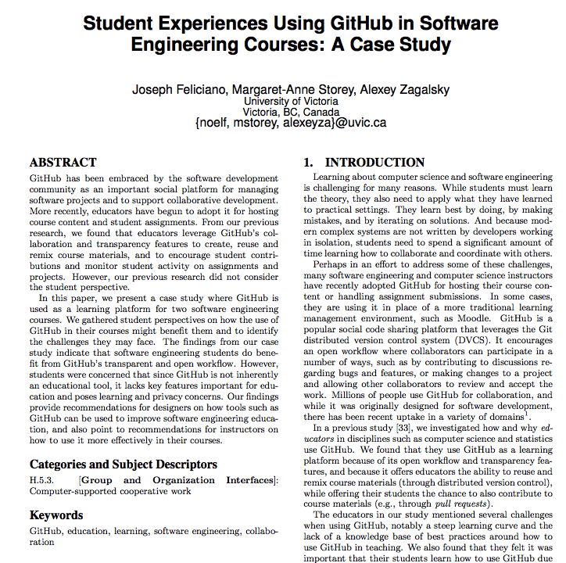
And another paper!
http://chisel.cs.uvic.ca/pubs/feliciano-ICSE2016.pdf

Slide 29
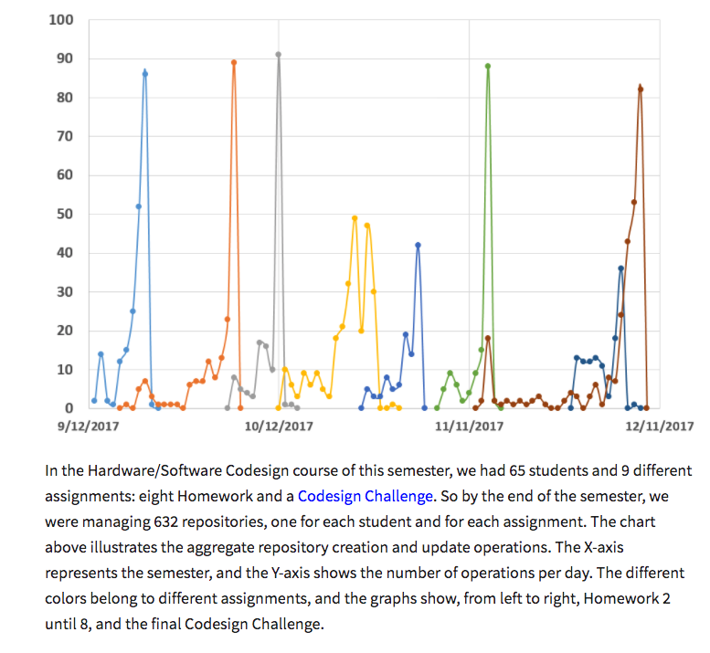
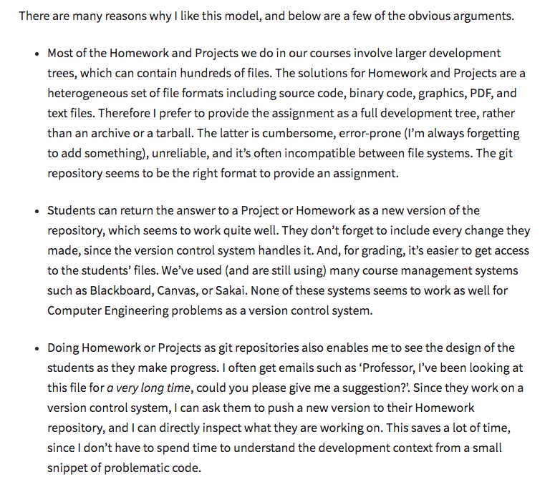
Another opinion from a teacher that used it
http://rijndael.ece.vt.edu/schaum//blog/ghclassroom/

Slide 30
An installable helper: https://github.com/education/classroom-desktop
Have not tested!

